Slide 1


Starter: Remind yourself of Tissue and The Emigrée
Tissue

Slide 2

Assessment Objectives
AO1: Read, understand and respond to texts. Students should be able to: maintain a critical style and develop an informed person response; use textual references, including quotations, to support and illustrate interpretations.
AO2: Analyse the language, form and structure used by a writer to create meanings and effects, using relevant subject terminology where appropriate.
AO3: Show understanding of the relationships between texts and the contexts in which they were written.
AO4: Use a range of vocabulary and sentence structures for clarity, purpose and effect, with accurate spelling and punctuation.
Notes:
Resource 1. Additional help for this task can be found on p. 6 & 7 in the poetry student book.

Slide 3
Date: 2006
Power & conflict
Title: Tissue
Poet: Imtiaz Dharker
Main Ideas/ Theme: Looking at the power of paper, despite its fragility, to overcome conflict and discrimination
Language:
Figurative language (simile and metaphor)
Assonance
Consonance
Modal verbs
Repetition
Delicate adjectives
Enjambment
Imagery: primarily based on paper, whole poem is an extended metaphor with paper representing human skin and life (look at the last line)
Tone: Reflective but revolutionary
Context: Dharker is a multicultural poet who has a cross cultural/ cross-religion identity
Rhythm/ Rhyme: No formal rhyme scheme, conversational rhythm

Slide 4
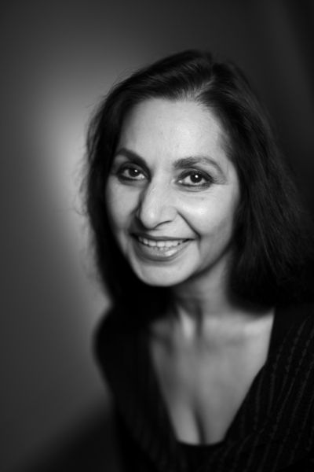

Imtiaz Dharker
Imtiaz Dharker is a contemporary poet who was born in Pakistan and grew up in Scotland. She has written five collections of poetry and often deals with themes of identity, the role of women in contemporary society and the search for meaning. She draws on her multi-cultural experience in her work.
She is also a film director and has scripted a number of documentaries in India, supporting work with women and children.
‘If there were to be a World Laureate, then for me the role could only be filled by Imtiaz Dharker.’ Carol Ann Duffy

Slide 5
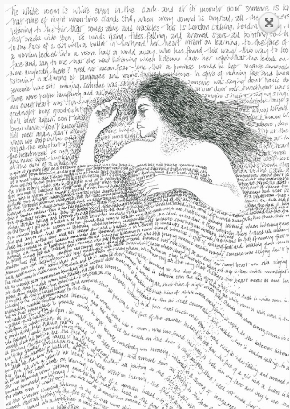
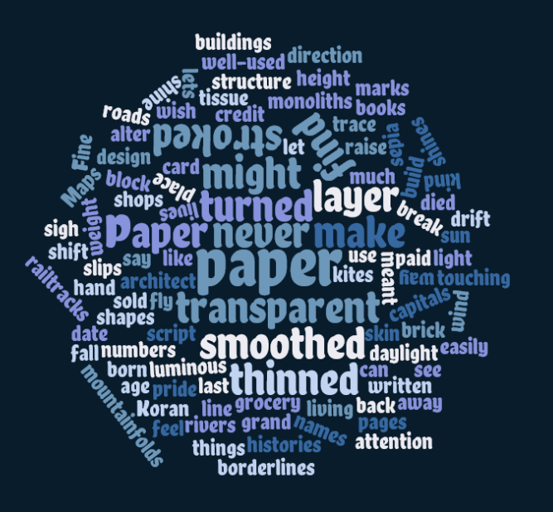

Slide 6
Date: 1993
Power & conflict
Title: The Emigrée
Poet: Carol Rumens
Main Ideas/ Theme: The conflict between memory and reality.
Prejudice faced by the emigrée
Language:
Personification
Repetition
Figurative language
Extended metaphor
Causura
Modal verbs
Contrast
Imagery:
Light and shade
Context: The memory of a childhood home to a woman who has had to leave. No details are given so could be anywhere
Tone: Nostalgic
Rhythm/ Rhyme: free verse

Slide 7
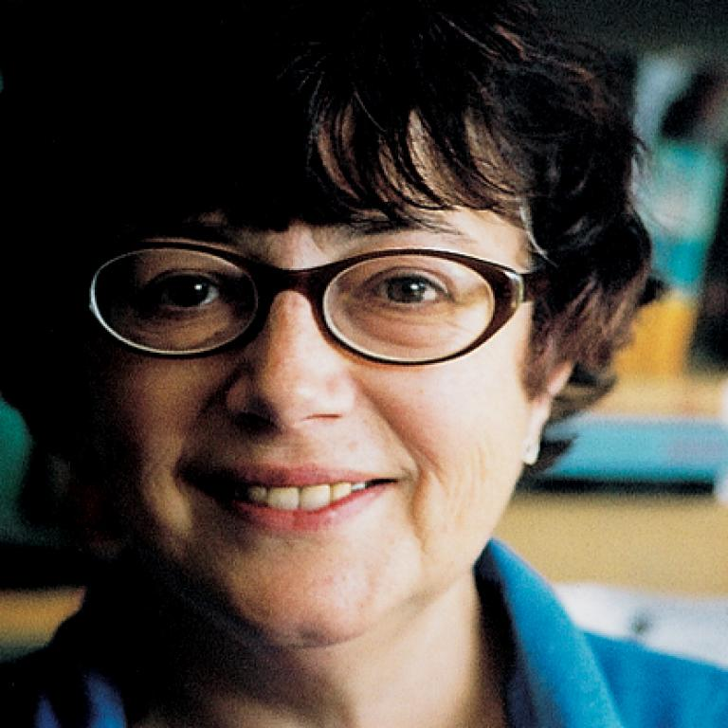
Carol Rumens
Carol Rumens was born in South London and grew up there. In addition to her own verse, she has published a number of translations of Russian poems and has, according to the critic Ben Wilkinson, a ‘fascination with elsewhere’. This fascination is clear in The Émigrée, which deals with a land and a city which for the speaker is permanently ‘elsewhere’.

Slide 8
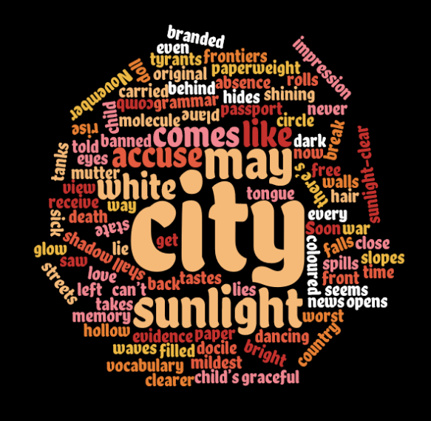

Slide 9
Comparing the poems
Feature/ technique | Tissue Imtiaz Dharker | The Emigrée Carol Rumens
Expression of regret over conflict involving boundaries | “Maps too. The sun shines through/ their borderlines” Conflict over borders leads to refugees and exiles. Dharker suggests that a more free approach would be better. | “My city takes me dancing through the city/ of walls” Even in her new home, there are “walls” Her country has lots of restrictions and she has “no way back at all”.
Imagery involving light | “The sun shines through/ their borderlines” “let the daylight break/ through capitals and monoliths” | “white streets of that city” Images of light and the colour white suggest purity, innocence and freedom.
Other poems | Ozymandias | Kamikaze

